Slide 1
Design Analysis & Algorithms
Presented By- Ayushi Nigam(HOD-CS)

Slide 2
Algorithm
An algorithm is a step-by-step procedure or set of well-defined instructions for performing a specific task or solving a particular problem
It is a finite sequence of precise, unambiguous, and executable steps that, when followed correctly, will produce the desired output or achieve the intended goal.

Slide 3
Characteristics of Algorithm
Finiteness: Algorithms must have a finite number of steps or instructions, which means they eventually terminate.
Preciseness: Each step of an algorithm must be clearly and unambiguously defined, leaving no room for interpretation or confusion.
Input: Algorithms take zero or more inputs, which can vary depending on the problem they aim to solve.
Output: Algorithms produce one or more outputs that represent the result or solution to the problem.
Effectiveness: Algorithms must be effective, meaning that they should accomplish their intended task or solve the problem for all possible valid inputs within a reasonable amount of time and resources.
Generality: Algorithms are designed to be applicable to a range of instances of a problem, rather than being specific to a single instance.

Slide 4
Algorithm design techniques
Brute force Technique
Divide and conquer
Dynamic programming
Greedy Approach
Backtracking
Branch & Bound
Randomized Algorithms

Slide 5
Complexity of Algorithm
The complexity of an algorithm refers to the analysis of the resources it consumes, primarily in terms of time and space, as a function of the input size.

Slide 6
Complexity analysis
There are two main types of complexity analysis:
Time Complexity: Time complexity measures the amount of time an algorithm takes to run as a function of the input size.
Space Complexity: Space complexity measures the amount of memory or storage an algorithm uses as a function of the input size.

Slide 7
Asymptotic notations
Asymptotic notations are essential for analyzing the time and space complexity of algorithms because they provide a way to express how the performance of an algorithm scales with input size without getting bogged down in precise constants or lower-order terms.

Slide 8
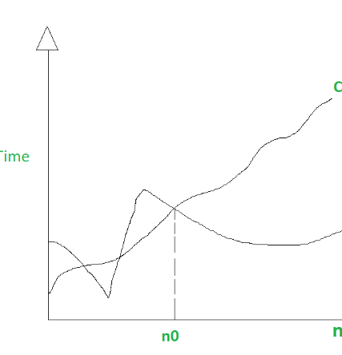
Big O Notation (O()):
Big O notation provides an upper bound on the growth rate of a function. It describes the worst-case behavior of an algorithm. In simpler terms, if a function f(n) is said to be O(g(n)), it means that, for sufficiently large n, the function f(n) grows no faster than a constant multiple of g(n).
Mathematically, f(n) = O(g(n)) if and only if there exist positive constants C and k such that:
|f(n)| <= C * |g(n)| for all n >= k

Slide 9
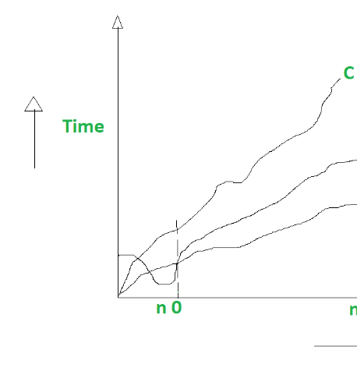
Big Theta notation (Θ)
Theta notation (Θ-notation) is a mathematical notation used in computer science and mathematics to describe the tight or exact bound on the growth rate of a function. It provides both an upper bound and a lower bound, which means it characterizes the behavior of a function within a certain range. Specifically, if a function f(n) is said to be Θ(g(n)), it means that there exist positive constants C1 and C2 and a value of n0 such that the function f(n) is sandwiched between C1 * g(n) and C2 * g(n) for all values of n greater than or equal to n0.
Mathematically, f(n) = Θ(g(n)) if and only if:
C1 * g(n) ≤ f(n) ≤ C2 * g(n) for all n ≥ n0

Slide 10
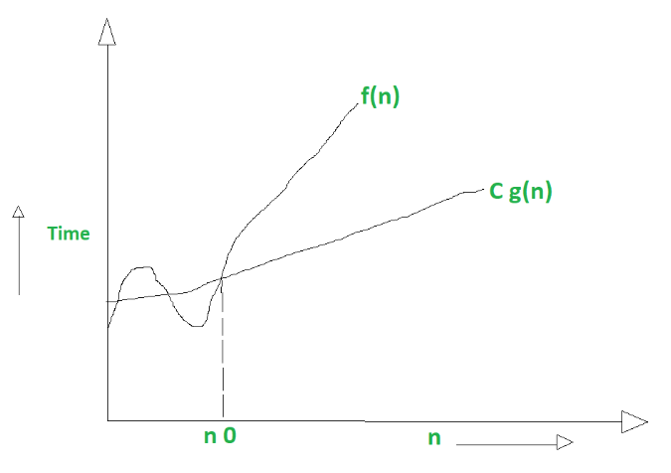
Big Omega notation (Ω)
Big Omega notation (Ω-notation) is a mathematical notation used in computer science and mathematics to describe the lower bound or best-case behavior of a function. It provides a way to express that a function grows at least as fast as another function, up to a constant factor, for sufficiently large input values. Specifically, if a function f(n) is said to be Ω(g(n)), it means that there exists a positive constant C and a value of n0 such that the function f(n) is greater than or equal to C * g(n) for all values of n greater than or equal to n0.
Mathematically, f(n) = Ω(g(n)) if and only if:
f(n) ≥ C * g(n) for all n ≥ n0

Slide 11
Recurrences
Recurrences are often used to analyze the time complexity of algorithms, model recursive processes, and solve problems that can be expressed recursively.
Solving recurrences involves finding an explicit formula or closed-form solution for the function or sequence being defined. There are several techniques for solving recurrences, including:
Substitution Method: This involves making an educated guess at the form of the solution and then proving it by induction.
Iteration Method: In this approach, you expand the recurrence by repeatedly substituting the recurrence relation until you see a pattern and can formulate a closed-form solution.
Master Theorem: The master theorem is a tool specifically designed for solving divide-and-conquer recurrences. It provides a way to determine the time complexity of algorithms without explicitly solving the recurrence.
Recurrence Tree Method: For divide-and-conquer recurrences, you can visualize the recurrence as a tree of recursive calls and analyze the levels of the tree to determine the overall time complexity.
Solving recurrences is essential for understanding the time complexity of recursive algorithms, which is crucial for algorithm design and analysis. It helps determine how algorithms perform as the input size increases and provides insights into their efficiency and scalability.

Slide 12
Sorting algorithms
Insertion sort
Merge Sort
Heap Sort
Quick Sort
Radix sort
Bucket Sort
Shell Sort

